Slide 1
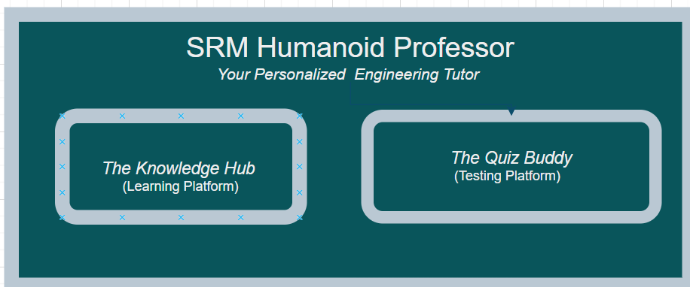
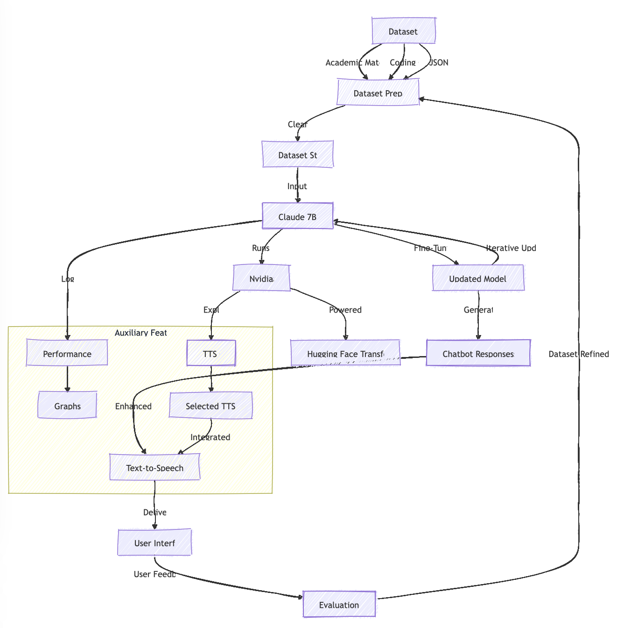
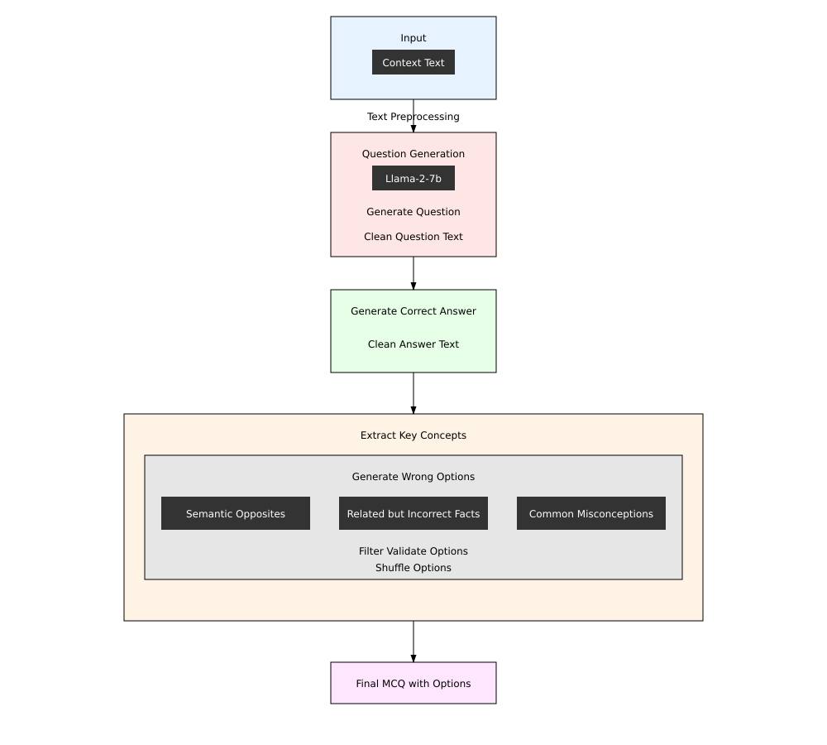
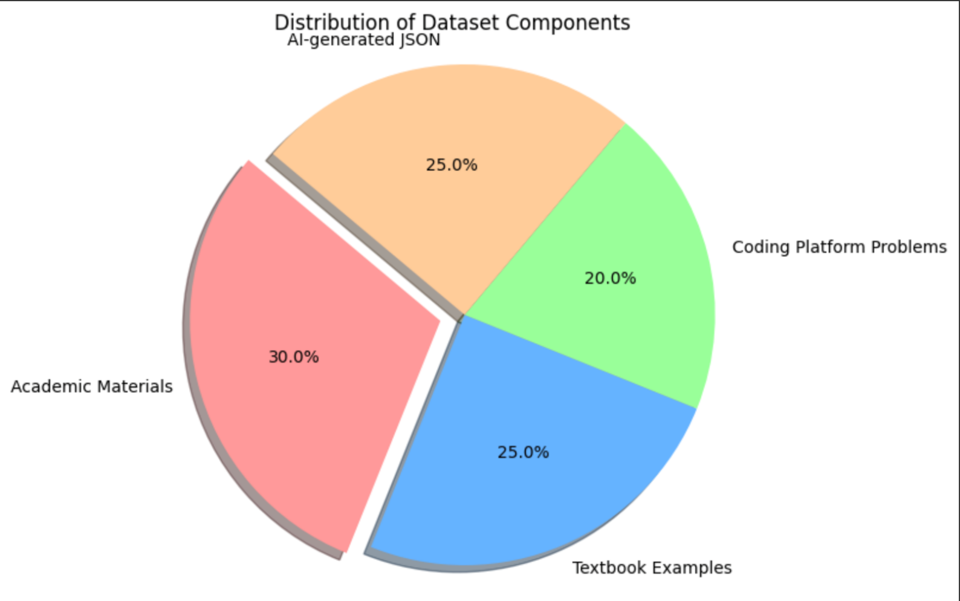
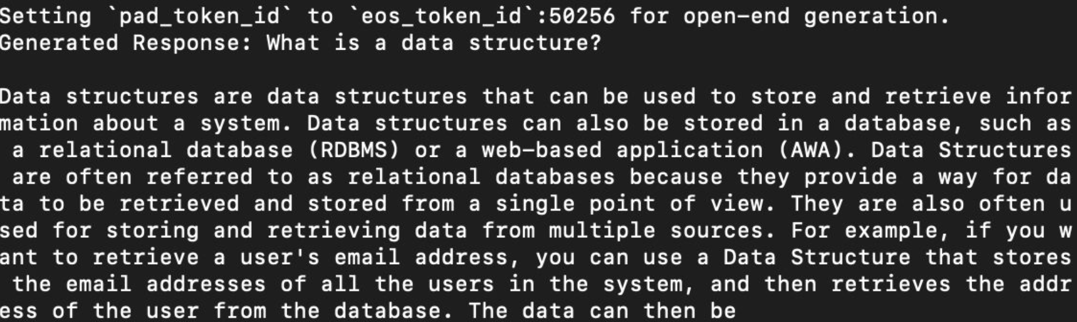
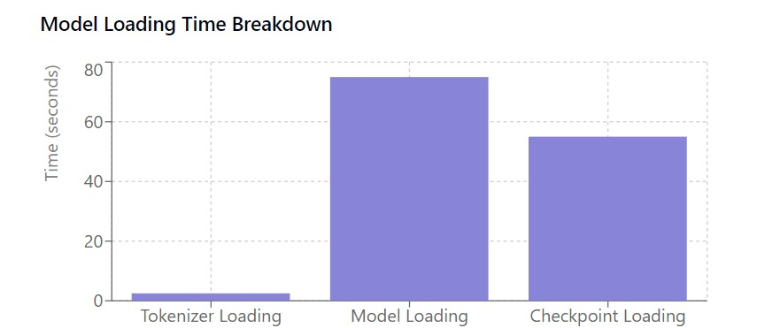
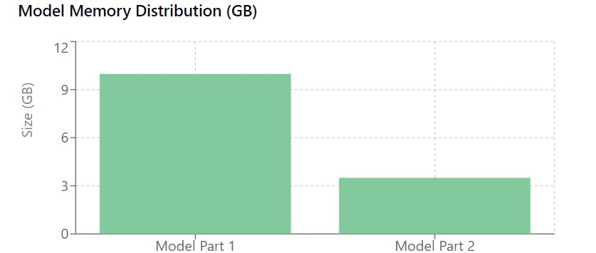
SRM Humanoid Professor: An LLM based Application for Engineering Subjects
Funded by SRM . Grant Amount: Rs. 7,42,275 (July 2022- June 2025)
PI : Dr. Subalalitha C.N . Co-PIs: Dr. Akilandeswari & Dr.Kayalvizhi R
Student Team : Bhupesh S , Hirithik R , Luvish Arora , Nikhil Sharma , Yash Srivastava , Gaurish Aradhy
OVERVIEW
HOW STUDENTS CAN USE THE PLATFORM
POTENTIAL BENEFICIARIES
The Humanoid Professor Learning Platform is an innovative AI-driven system designed to make learning computer science subjects engaging and interactive. Initially focusing on Data Structures, the platform combines advanced language models like Claude with state-of-the-art Speech-to-Text and Text-to-Speech capabilities to create a seamless learning experience.
The learning platform offers dynamic, conversational teaching sessions, allowing students to explore complex concepts in an intuitive, question-and-answer format. It supports multiple learning styles by enabling voice-based interactions alongside text-based explanations, making it accessible to a diverse range of users.
Coupled with the Quiz Buddy testing platform, which evaluates students' understanding through interactive quizzes, the Humanoid Professor system empowers learners to gain a solid foundation in computer science while receiving real-time feedback and personalized guidance. This blend of cutting-edge technology and pedagogical innovation positions the platform as a comprehensive solution for mastering technical subjects.
.
.
The Humanoid project has the potential to benefit a diverse audience, including students, educators, developers, and organizations. For students, it provides an interactive humanoid to learn and practice data structures and algorithms, while educators can use it as a supplementary teaching tool to explain complex concepts. Developers and programmers can rely on the humanoid for debugging and solving challenges, with competitive programmers leveraging it to enhance their preparation and master advanced scenarios. Organizations can deploy the model for employee training or technical interviews, and technology platforms, such as online learning or coding practice websites, can integrate it to offer engaging and automated assistance.
Log In and Select Data Structures
Sign in to the platform and choose the Data Structures module to access topics like arrays, trees, and graphs.
Interactive Learning Sessions
Learn concepts through conversations with the AI-powered Humanoid Professor, using text or voice commands for explanations and examples.
Practice with Exercises
Solve coding challenges and interactive problems with instant feedback to solidify your understanding.
Test Your Knowledge
Use Quiz Buddy to assess your progress with quizzes and receive performance insights.
Track and Revise
Monitor your progress, revisit saved lessons, and review summaries for continuous improvement.
TESTING RESULTS
SYSTEM OVERVIEW
The performance of the model was evaluated through systematic testing to ensure its ability to comprehend and respond to DS-Alg questions effectively. The process involved leveraging a curated JSON dataset and analysing the model’s outputs against benchmark standards.
1. Dataset Analysis
The dataset, structured in JSON format, contains a rich collection of DS-Alg questions paired with accurate answers. Each entry is tagged with specific metadata to enhance the model’s ability to learn and generalize. This structured approach ensures clarity and consistency during training and evaluation.
.
SYSTEMATIC PROCESS FOR KNOWLEDGE HUB
Fig.1 Overview of the SRM Humanoid platform
WORKING ALGORITHM
1. Dataset Preparation
• Collect data from academic materials, textbooks, and online problem sets.
• Clean the dataset to remove noise and inconsistencies.
• Annotate and structure the data into input-output pairs (question-answer format).
• Split the data into training, validation, and test sets.
2. Model Setup
• Load the pre-trained Claude 7B model from Hugging Face.
• Tokenize and preprocess the input data for model compatibility.
• Fine-tune the model using the prepared dataset.
3. Speech Integration
• Integrate Text-to-Speech (TTS) functionality using Google TTS API or Hugging Face TTS.
• Validate the synchronization of textual responses with audio generation.
4. Training the Model
• Use supervised learning to fine-tune the model iteratively.
• Monitor training performance using metrics such as loss and accuracy.
• Adjust hyperparameters to improve model performance.
5. Evaluation and Testing
• Test the model on basic DS-Alg problems to evaluate performance.
• Conduct advanced tests on complex algorithmic scenarios.
6. Refinement and deployment
Incorporate feedback into the dataset and retrain the model.
Deploy the model in NIVIDIA JETSON and integrate on to a robot or host as a web application
Fig. 2 Illustrative process visualization
Fig 5. Systematic Process For QuizBuddy
GRAPH VISUALIZATION
2. Model Testing and Validation
The trained model was rigorously tested using the prepared dataset. Responses were analyzed for correctness, relevance, and clarity, enabling the identification of areas requiring refinement. Performance metrics such as accuracy, latency, and contextual alignment were measured and optimized iteratively. (Refer Fig. 6: Output of Model Testing with the Dataset)
3. Insights and Refinements
Observations from testing highlighted areas where the model excelled in answering DS-Alg questions, as well as opportunities for improvement. Iterative enhancements were applied to ensure the model’s output aligns with the intended academic rigor.
The pie chart visualizes the distribution of various components in the dataset used for the humanoid project, which focuses on data structures and algorithms (DS-Algo).
Fig 3. Pie Chart
Fig 6. Output of Model Testing with the Dataset
Advanced Evaluation and Iterative Refinement
The model was rigorously evaluated using advanced metrics like accuracy and precision, comparing its responses to ground truth data, and Latent Semantic Analysis (LSA) to ensure contextual alignment. Inference speed was measured for real-time efficiency, while detailed error analysis identified improvement areas. An iterative feedback mechanism further refined the model, leveraging user feedback and error patterns to enhance accuracy and robustness across successive iterations. This approach ensured a balance of performance, reliability, and scalability for DS-Algo problem-solving.
Fig 4. Model loading time breakdown / model memory distribution

